Slide 1
COMP 3400
Week 14 – Friday

Slide 2
Last time
What did we talk about last time?
Review up to Exam 2
Networking
Application
Transport
Internet
Link
Physical
Socket programming
Peer-to-peer networks
HTTP
TCP vs. UDP
Network security
CIA
Symmetric and public key cryptography
Cryptographic hash functions

Slide 3
Questions?

Slide 4
Assignment 8

Slide 5
Review

Slide 6
Final exam format
Final exam will be in this room:
Wednesday, April 30, 2025
8:00 – 10:00 a.m.
50% longer than previous exams, but you have 100% more time
Mostly short answer questions
One or two matching questions
A couple of debugging questions
A couple of programming questions

Slide 7
Threading

Slide 8
Threads and processes
Many processes can run concurrently
Each one executes independently
Each process has its own memory layout
Many threads can also run concurrently
Each one executes independently
Each thread has its own stack to keep track of its function calls
But all threads within a process share code, data, heap, and kernel segments
Just as we used fork() to spawn new processes, there are libraries to spawn new threads within a process and coordinate them

Slide 9
Advantages of threads
Using threads allows for more modular software since threads can call the same functions within a program
Threads can be more efficient since there's no context switch needed for different threads to interact
Some models of programming like GUIs depend on threads so that one unit of code needs can react to an action taken elsewhere
Since threads share memory, there's no need for IPC libraries

Slide 10
Disadvantages of threads
Threads are less isolated from each other than separate processes
Consequences:
A thread crashing from a segmentation fault will kill the entire process, including the other threads
Bugs called race conditions occur, where the behavior of the program is different depending on which thread executed first

Slide 11
Race conditions
Race conditions are a central problem with threads
Thread scheduling is non-deterministic
It's often impossible to predict when the statements from one thread are going to be executed with respect to those in another thread
If the statements modify the same memory, the results can be inconsistent
One of the most frustrating issues with race conditions is that they can occur rarely
This means that you can run your program 1,000 times with no problems, only to crash badly on time 1,001

Slide 12
Critical sections
A critical section is a series of statements that must be executed atomically to get the right result
Atomic execution means that all the statements happen as if they happened at once, without other statements from other threads interfering
Even statements that look atomic like i++ are actually several different operations in assembly language
movq _globalvar(%rip), %rsi # copy from memory into %rsi register
addq $1, %rsi # increment the value in the register
movq %rsi, _globalvar(%rip) # store the result back into memory

Slide 13
Incrementing variables
Consider two threads that share an int variable called global that is initially set to 0:
What are the largest and smallest values that global could have after these threads run to completion?
Thread A
Thread B
for (int i = 0; i < 200; ++i)
++global;
for (int j = 0; j < 300; ++j)
++global;

Slide 14
Thread safety
Many functions are thread safe, meaning that they can be called by many threads at the same time and still give the right answers
Other functions are not thread safe
Examples: rand() and strtok()
The usual reason that functions are not thread safe is because they contain static local variables
Because these variables are shared by all threads, they can become corrupted

Slide 15
POSIX Threads

Slide 16
POSIX threads
Just as we could create a new process with fork(), there are libraries for making new threads
POSIX threads (also called pthreads) are perhaps the most widely used thread library
Windows (of course) has its own threading library, though people have built POSIX-like libraries on top of it
Key POSIX concepts
Creating a thread starts it running
A thread can exit, stopping its running
Joining a thread means waiting for a thread to finish (and potentially getting its result)
We keep track of processes with an ID of type pid_t, but we keep track of threads with an ID of type pthread_t

Slide 17
POSIX thread functions
Here are POSIX functions mapping to concepts from the previous slide
Create a new thread (not as bad as it looks)
Exit from the current thread (giving a pointer to the result, if any)
Join a thread (getting a pointer to its result, if any)
int pthread_create (pthread_t *thread, const pthread_attr_t *attr,
void *(*start_routine)(void*), void *arg);
void pthread_exit (void *value_ptr);
void pthread_join (pthread_t thread, void *value_ptr);

Slide 18
Creating a thread
Creating a thread is the most complicated function, partly because it takes a function pointer and potentially arguments
thread is a pointer to a pthread_t that will get filled in with the thread's ID
attr is a pointer to possible thread attributes (often left NULL)
start_routine is a pointer to a function that takes a void* and returns a void*
arg is a pointer to arguments, NULL if no arguments needed
int pthread_create (pthread_t *thread, const pthread_attr_t *attr,
void *(*start_routine)(void*), void *arg);

Slide 19
Simple threading example
#include <stdio.h>
#include <pthread.h> // POSIX thread library
#include <assert.h>
void *
start_thread (void *args) // Function to start thread with
{
printf ("Hello from thread!\n");
pthread_exit (NULL);
}
int
main (int argc, char **argv)
{
pthread_t child_thread;
// Create new thread with function start_thread
assert (pthread_create (&child_thread, NULL, start_thread, NULL) == 0);
pthread_join (child_thread, NULL); // Wait for other thread to finish
pthread_exit (NULL); // main() exits like any other thread
}

Slide 20
Common mistakes
Passing in a garbage pthread_t* instead of the address of a real pthread_t
Calling the threading function (with parentheses) instead of passing a function pointer in
Joining with a pthread_t* instead of a pthread_t
pthread_t *thread; // No!
pthread_create (thread, NULL, start (), NULL); // No!
pthread_join (thread, NULL); // No!

Slide 21
Passing arguments
Passing arguments to threads is tricky
Passing addresses to objects on the stack is dangerous in case the function creating the threads returns
Passing pointers to the same object to multiple threads can cause problems if they fight over it
There are no timing guarantees over which thread will run when

Slide 22
A useful hack
On most modern machines, a pointer is either 32 bits or 64 bits
An int is usually 32 bits
We can cast an int to a pointer and pass that to the thread
The thread will then cast the pointer back to an int
Since the size of an int is almost always less than a pointer, we don't lose any information
It's icky, but it allows us to pass simple values like a char, short, or int
Both floating-point types are harder since they have to be tricked into behaving like integers (which pointers fundamentally are)
And double is risky since it needs a 64-bit pointer to hold it all

Slide 23
A thread function that uses a pointer like an int
void * child_thread (void *args)
{
int value = (int) args; // Now, I pretend it's an int!
printf ("I'm a thread with value: %d\n", value);
pthread_exit (NULL);
}
int main (int argc, char **argv)
{
pthread_t threads[10]; // Array to hold thread IDs
// Start up those threads, pretending ints are pointers
for (int i = 0; i < 10; i++)
pthread_create (&threads[i], NULL, child_thread, (void*)i);
for (int i = 0; i < 10; i++)
pthread_join(threads[i], NULL);
pthread_exit (NULL);
}

Slide 24
Passing multiple arguments to a thread
To pass multiple arguments, they're often grouped in a struct
Remember that threads all have their own stacks
Thus, we need to pass in a struct that has been dynamically allocated on the heap (which is shared)
Also, any pointers that struct contains should point at memory that isn't on the stack

Slide 25
Multiple argument example
struct thread_args
{
int value;
const char* string;
};
int main (int argc, char **argv)
{
pthread_t thread;
struct thread_args* args = malloc(sizeof(struct thread_args));
args->value = 42;
args->string = "wombat";
// Thread casts void* to struct thread_args* when it gets it
pthread_create (&thread, NULL, child_thread, args);
pthread_join(thread, NULL);
pthread_exit (NULL);
}

Slide 26
Returning values from threads
A common model for threads is for them to go and perform some work
After the work is done, they need to give back the answer
There are three ways to do this:
Store the answer back into the dynamically allocated struct passed in for its arguments
Use the hack like before to return a "pointer" through the join that's actually an int
Return a pointer through the join to a dynamically allocated struct containing the answer

Slide 27
Synchronization

Slide 28
Synchronization
Now you have all the tools needed to create, run, and join threads
But you don't have any tools to avoid the problem of race conditions
Synchronization is used to coordinate between threads, often by enforcing critical sections, sections of code that only one thread can be executing at a time
Common synchronization tools:
Locks (mutexes)
Semaphores
Barriers
Condition variables
If used incorrectly, however, synchronization tools can lead to other problems such as deadlock and livelock

Slide 29
Examples of synchronization
The following are common examples of synchronization:
Multiple threads share a data structure, but only one can write to it at a time
Only so many threads can access a shared resource to avoid slowdowns
Certain events need to happen in a certain order
Some calculations must be done before an action can be taken
Performing synchronization so that the result is correct while avoiding performance penalties is challenging

Slide 30
Critical sections
Recall that a critical section is a section of code that it's safe for only a single thread to be executing
Often this is because non-atomic memory accesses (such as reading a value, doing calculations, and then writing back to memory) can get inconsistent results if more than one thread is executing them concurrently
A common use of synchronization tools is to block threads trying to access a critical section if a thread is already executing it

Slide 31
Locks
A key synchronization tool is called a lock (or a mutex, short for mutual exclusion)
Critical sections can be protected by a lock
First code acquires the lock
Then it performs the code in the critical section
Then it releases the lock
For POSIX threads, lock functionality is provided by several mutex functions that operate on pthread_mutex_t objects

Slide 32
Lock features
Mutual exclusion
Locks start unlocked
Only one thread can acquire a lock at a time
No other thread can acquire a lock until it's been released
Non-preemption
A lock must be voluntarily released by the thread that acquired it
Atomic operations
Acquire and release are atomic operations
Blocking acquires
If a thread tries to acquire a lock, it's blocked and added to the queue
When the thread holding the lock releases it, only one thread acquires it

Slide 33
POSIX mutex functions
int pthread_mutex_init (pthread_mutex_t *mutex,
const pthread_mutexattr_t *attr);
Create a mutex with the specified attributes
Destroy an existing mutex
Acquire a mutex, blocking until you succeed
Try to acquire a mutex, returning non-zero if another thread has the mutex
Release the mutex
int pthread_mutex_destroy (pthread_mutex_t *mutex);
int pthread_mutex_lock (pthread_mutex_t *mutex);
int pthread_mutex_trylock (pthread_mutex_t *mutex);
int pthread_mutex_unlock (pthread_mutex_t *mutex);

Slide 34
How long should critical sections be?
Now that you have locks that you can use to protect a critical section, how should you use them?
In general, you want critical sections to be short so that one thread won't block another unnecessarily
Nevertheless, breaking up one section of code into several critical sections will introduce penalties because acquiring and releasing locks isn't free

Slide 35
Semaphores
We mentioned semaphores in the context of synchronizing processes that shared memory
We can use semaphores to synchronize threads as well
Recall that we think of a semaphore as a non-negative integer that can be incremented and decrementing atomically
Calling sem_wait() (decrement) on a semaphore at 0 will block until another thread calls sem_post() (increment)

Slide 36
Semaphore functions
sem_t *sem_open (const char *name, int oflag,
/* mode_t mode, unsigned int value */ );
Return (and possibly create) a named semaphore, using the usual oflag and mode flags
value determines the initial value of the semaphore (often 0)
Block if the semaphore's value is 0, decrement after continuing
Increment the semaphore's value, unblocking a process if the value is 0
Close a semaphore
Delete a semaphore
int sem_wait (sem_t *sem);
int sem_post (sem_t *sem);
int sem_close (sem_t *sem);
int sem_unlink (const char *name);

Slide 37
Semaphores for signaling
We can use semaphores to signal some event to another thread
As in our earlier examples with semaphores, we initialize the semaphore to 0
The thread waiting for the event will call sem_wait() on the semaphore
The thread signaling that the event has happened will call sem_post()
The waiting thread will be awoken when the signaling thread posts
If the signaling thread posts before the waiting starts waiting, it won't have to wait

Slide 38
Mutual exclusion with semaphores
It should be unsurprising that we can use semaphores instead of locks (POSIX mutexes)
To do so, we initialize the semaphore to a value of 1
When entering a critical section, a thread waits on (downs) the semaphore
When leaving a critical section, the thread posts on (ups) the semaphore
The first thread reaching the critical section is allowed in because the value is 1
If we had initialized to 0, no threads could enter the critical section

Slide 39
Semaphores as multiplexing
Semaphores can also be used for multiplexing, in which a maximum number of threads are allowed to access a resource
Consider a club where the bouncer only lets 100 people in
This kind of synchronization is used less than signaling and mutexes, but it can be useful to prevent slowdown from too many threads using a resource
Also, it can be used to prevent possible race conditions when there's a fixed number of items but the threads themselves have to select the one they want
No more than the maximum number of threads will be allowed to do selection

Slide 40
Semaphore summary
Semaphores are a flexible tool that can be used for signaling, mutual exclusion, and multiplexing
The key is the initial value of the semaphore
0 for signaling
1 for mutual exclusion
Greater than 1 for multiplexing
Conceptually, the initial value of the semaphore is the maximum number of concurrent accesses

Slide 41
Barriers
Sometimes a bunch of threads are working on a task that has phases
We want to guarantee that all threads have finished Phase 1 before moving on to Phase 2
To guarantee this, we can use barriers
A barrier prevents threads from continuing unless k threads have reached it
It's common for k to be the total number of threads
Sometimes, however, the calculation is fine as long as at least k are done
It's possible to do this kind of coordination with semaphores, but it's hard to get it exactly right

Slide 42
Barrier functions
int pthread_barrier_init (pthread_barrier_t *barrier, const pthread_barrierattr_t *attr, unsigned count);
Create a barrier with the attributes given (often NULL) and the count of threads blocked
Free up the resources associated with a barrier
Wait on a barrier until enough threads reach it
int pthread_barrier_destroy (pthread_barrier_t *barrier);
int pthread_barrier_wait (pthread_barrier_t *barrier);

Slide 43
Merge sort
We can imagine a threaded merge sort that works in this way:
Each thread is assigned a section of the array to sort
Each thread uses merge sort to sort that part of the array
All threads wait on a barrier
Then
Even numbered threads merge together their section with the neighboring section
Threads that are multiples of four merge together double sections with other double sections
Threads that are multiples of eight merge together quadruple sections with other quadruple sections
…

Slide 44
Threaded merge sort visualized
Each thread is assigned a section of an array and sorts it
Since there's no overlap, each thread can work independently
After sorting, all threads wait on a barrier to be sure that every thread has finished sorting
Values
Threads | 0 |  |  |  | 1 |  |  |  | 2 |  |  |  | 3 |  |  |  | 4 |  |  |  | 5 |  |  |  | 6 |  |  |  | 7

Slide 45
Final merging visualized
Threads can't merge the same parts of the array without causing race conditions
Half the threads merge with their neighbors
Then, half of those merge
And so on, until it's all merged
Values
Threads | 0 |  |  |  |  |  |  |  | 2 |  |  |  |  |  |  |  | 4 |  |  |  |  |  |  |  | 6
Values
Threads | 0 |  |  |  |  |  |  |  |  |  |  |  |  |  |  |  | 4
Values
Threads | 0

Slide 46
Weaknesses of semaphores
Semaphores are very general purpose concurrency tool, but they have some weaknesses:
Semaphores take thought to use correctly: Incrementing and decrementing values don't map clearly to synchronization problems
Different implementations of semaphores have different features
Some systems (like macOS) don't have a full implementation of semaphores
Semaphores can only signal to one thread: no broadcasting
After getting a signal, threads have to take another step (like acquiring a lock) to get mutually exclusive access, time that can allow a race condition

Slide 47
Condition variables
Condition variables try to overcome some weaknesses of semaphores by tying themselves directly to a lock
They also have the ability to broadcast, waking up all waiting threads
Like semaphores, they still have a function to wait and a function to signal
However, something sneaky happens with wait:
First, the thread must acquire a lock
Then, it calls the wait function
If it has to wait, it releases the lock but then reacquires it when it gets woken up
All of which happens atomically
This allows a thread to safely check a condition and wait until it gets signaled
Think of a condition variable as a queue for waiting threads

Slide 48
Deadlock

Slide 49
Deadlock
In order to avoid race conditions, we introduced several synchronization tools:
Locks (mutexes)
Semaphores
Barriers
Condition variables
Each of these can be misused, failing to avoid race conditions
Likewise, each introduces overhead, slowing the system down
But an even worse possibility is deadlock

Slide 50
Deadlock
Deadlock occurs when the use of synchronization primitives cause threads to get stuck so that they will never make progress again
A lock that never gets unlocked
A semaphore that never gets posted on
A barrier that is never reached by enough threads
A condition variable that is never signaled on
Like many concurrency problems, deadlock can occur rarely or it can happen every time a program runs

Slide 51
Deadlock example
In the following code, deadlock is possible
struct args {
pthread_mutex_t lock_a;
pthread_mutex_t lock_b;
};
void * first (void * args)
{
struct args *data = (struct args *) args;
pthread_mutex_lock (&data->lock_a); // Lock A
pthread_mutex_lock (&data->lock_b); // Then lock B
// More code (that would eventually unlock A and B)
}
void * second (void * args)
{
struct args *data = (struct args *) args;
pthread_mutex_lock (&data->lock_b); // Lock B
pthread_mutex_lock (&data->lock_a); // Then lock A
// More code (that would eventually unlock A and B)
}

Slide 52
Possible states
The following state diagram shows the states the threads can be in:
First Locked Both
First Unlocks Both
Both Unlocked
Second Unlocks Both
Second Locked Both
First Locks A
Second Locks B
First Locked A
Second Locks B
Deadlock
First Locks A
Second Locked B

Slide 53
Why does this happen?
The two threads try to acquire locks in different orders:
First tries to get lock A followed by lock B
Second tries to get lock B followed by lock A
If they tried to get the locks in the same order, we would never have this problem
Even so, real situations are more complex
Threads might need to acquire a number of locks for a number of resources
The order might be hard to predict ahead of time

Slide 54
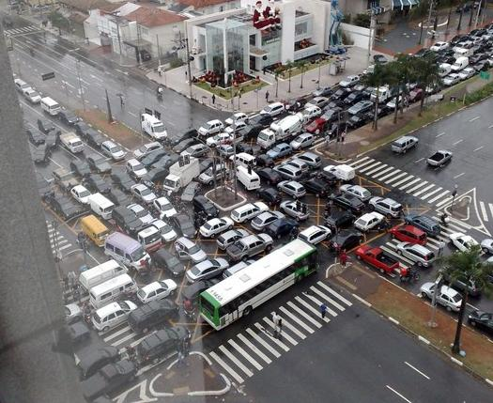
Necessary conditions
Four conditions are needed for deadlock to be possible:
Mutual exclusion: Once a resource has been acquired, no other thread gets it
No preemption: Threads can't be made to give up their resources
Hold and wait: Threads can get one resource and keep it while trying to get others
Circular wait: Thread A needs a resource held by Thread B, and Thread B needs a resource held by Thread A (or extend to a chain of threads)
Conditions 1 through 3 are unavoidable, so solutions often focus on avoiding circular wait

Slide 55
Livelock
Livelock is similar to deadlock
It's a condition where, due to bad timing, processes continue executing code, but they never make progress beyond a certain point
They're acquiring resources, giving them up, and acquiring them again, but still blocking each other
If the system is set up in a certain way or is very unlucky, livelock could continue indefinitely
Livelock can also sometimes resolve

Slide 56
Avoiding deadlock
As mentioned before, we usually concentrate on the circular wait condition of deadlock:
Order the resources and always acquire them in the same order
Use timed or non-blocking versions of functions that acquire resources, potentially causing livelock
Limit the number of threads that can access the resources, insuring that there's always enough resources to go around

Slide 57
Synchronization Design Patterns

Slide 58
Signaling
Signaling is a design pattern we've already discussed
One thread needs to wait until a event has occurred
A second thread signals the first
POSIX thread implementation:
Initialize a semaphore to 0
Have the first thread call sem_wait() on the semaphore when it needs to wait
Have a second thread call sem_post() when the event has occurred
Because semaphores have an integer value, the scheduling of the threads doesn't matter
If the second thread has already signaled, the first thread will immediately return from sem_wait()

Slide 59
Turnstiles
Unlike signaling, which unblocks a single thread, the turnstile design pattern is used to unblock many threads when an event occurs
POSIX implementation:
Initialize a semaphore to 0
Have a thread call sem_post() on the semaphore when the event occurs
All threads that need to wait call sem_wait() followed by sem_post()
Each thread waking up will wake up one more
Turnstiles work similarly to the broadcast function for condition variables
But broadcasts will only wake up those threads that are currently waiting
Turnstiles let all threads pass through, even if they reach the sem_wait() after the event has already happened

Slide 60
Rendezvous
In the rendezvous pattern, two threads signal that they have both reached a specific point in execution
POSIX implementation:
Initialize semaphore A and semaphore B to 0
Thread 1 calls sem_post() on semaphore A and sem_wait() on semaphore B
Thread 2 calls sem_post() on semaphore B and sem_wait() on semaphore A
Each thread will only get blocked until the other one signals
Order matters! Flip the waits with the posts and you'll have deadlock
For larger numbers of threads, using a barrier might be a better approach

Slide 61
Multiplexing
Multiplexing is another design pattern we've already mentioned
Multiplexing is useful when mutual exclusion is more restrictive than you need, but you still want to limit the total number of threads able to execute a section of code
POSIX implementation:
Initialize a semaphore to n, where n is the maximum number of concurrent accesses you want to allow
Each thread calls sem_wait() on the semaphore before executing the code
Each thread calls sem_post() on the semaphore after executing the code
This design pattern can be useful when spawning threads on a server to handle requests
We want to prevent too many threads from being created in order to avoid bogging down the server

Slide 62
Lightswitches
We sometimes want to allow multiple threads of a certain kind to run code concurrently but force others to use mutual exclusion
Many threads that only read memory, for example, could access the memory at the same time
But only one thread that writes memory should be allowed in
The lightswitch design pattern allows this kind of access
The name comes from the idea that the first person into a room turns on a lightswitch and the last person turns it off
POSIX implementation:
Initialize a semaphore to 1
Initialize a counter variable to 0
Create a lock
Whenever a reader thread wants to read:
It acquires the lock
Increments the counter
If the counter is 1, call sem_wait() on the semaphore
Unlock the lock
Whenever a reader thread is done reading:
It acquires the lock
It decrements the counter
If the counter is 0, it calls sem_post() on the semaphore
Unlock the lock
Writers simply call sem_wait() to start writing and sem_post() when done

Slide 63
Producer-Consumer

Slide 64
Producer-consumer
The producer-consumer problem comes up all the time in concurrent systems
One or more threads is producing elements that go into a buffer
One or more threads is consuming elements from the buffer
A producer can't put an item into a full buffer and must block
A consumer can't remove an item from an empty buffer and must block
Example:
An OS thread is putting data into a buffer that's coming across the network
A user thread is trying to read data out of that buffer

Slide 65
Unsafe producer-consumer with a bounded queue
Our implementation uses a circular array (that wraps back around to the beginning)
The following code is unsafe for two reasons:
It doesn't check to see if the buffer is full when enqueuing or empty when dequeuing
Changing queue data is unsafe for a multi-threaded application
void enqueue_unsafe (queue_t *queue, data_t *data)
{
// Store the data in the array and advance the index
queue->contents[queue->back++] = data;
queue->back %= queue->capacity;
}
data_t * dequeue_unsafe (queue_t *queue)
{
data_t * data = queue->contents[queue->front++];
queue->front %= queue->capacity;
return data;
}

Slide 66
Safe producer-consumer with a bounded queue and a single producer and consumer
We could use locks and check a variable giving the total number of elements in the queue
However, semaphores have this feature built in
We initialize the space semaphore to the maximum size of the queue
We initialize the items semaphore to 0
void enqueue (queue_t *queue, data_t *data, sem_t *space, sem_t *items)
{
sem_wait (space);
enqueue_unsafe (queue, data);
sem_post (items);
}
data_t * dequeue (queue_t * queue, sem_t *space, sem_t *items)
{
sem_wait (items);
data_t * data = dequeue_unsafe (queue);
sem_post (space);
return data;
}

Slide 67
Safe producer-consumer with a bounded queue and multiple producers and consumers
Unfortunately, the two semaphores aren't enough when there are multiple producers and consumers
In that situation, two producers could both be calling enqueue_unsafe(), potentially causing a race condition with the increment
The solution is to one lock for producers and one lock for consumers
We could use a single lock for both, but using two locks allows producers and consumers to modify the queue concurrently yet safely
void enqueue (queue_t *queue, data_t *data, sem_t *space, sem_t *items, pthread_mutex_t *producer_lock)
{
sem_wait (space);
pthread_mutex_lock (producer_lock);
enqueue_unsafe (queue, data);
pthread_mutex_unlock (producer_lock);
sem_post (items);
}
data_t * dequeue (queue_t * queue, sem_t *space, sem_t *items, pthread_mutex_t *consumer_lock)
{
sem_wait (items);
pthread_mutex_lock (consumer_lock);
data_t * data = dequeue_unsafe (queue);
pthread_mutex_unlock (consumer_lock);
sem_post (space);
return data;
}

Slide 68
Readers-Writers

Slide 69
Readers-Writers
What if we have a situation where we want to allow an unlimited number of reader threads to read data?
But if a single writer needs to write, no other threads can access the data
Changing the data can cause race conditions, but merely reading it concurrently is fine
And can make reading much faster!

Slide 70
First solution: Lightswitches
This is exactly the scenario we solved with lightswitches:
Initialize a semaphore to 1
Initialize a counter variable to 0
Create a lock
Whenever a reader thread wants to read:
It acquires the lock
Increments the counter
If the counter is 1, call sem_wait() on the semaphore
Unlock the lock
Whenever a reader thread is done reading:
It acquires the lock
It decrements the counter
If the counter is 0, it calls sem_post() on the semaphore
Unlock the lock
Writers call sem_wait() to start writing and sem_post() when done

Slide 71
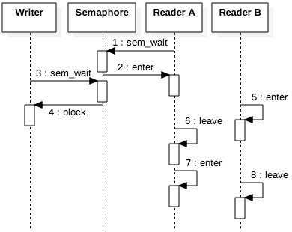
What's the problem with this solution?
When a reader comes into the room, it becomes blocked for writers
If more readers come in before others leave, writers might never get to enter
What do we do?

Slide 72
Second solution: Add a turnstile
We add a turnstile for the readers
They pass through without any problem at first
When a writer wants to write, it waits on the reader semaphore
This blocks any new readers from entering

Slide 73
Illustration of second solution
The system starts off with its two semaphores having the following values:
Lightswitch: 1
Turnstile: 1
Reader 1 Enters
Reader 2 Enters
Writer Tries to Enter (Blocked)
Reader 3 Tries to Enter (Blocked)
Reader 1 Exits
Reader 2 Exits
Writer Enters
Writer Exits
Reader 3 Enters
Lightswitch: 0
Turnstile: 1
Lightswitch: 0
Turnstile: 1
Lightswitch: 0
Turnstile: 0
Lightswitch: 0
Turnstile: 0
Lightswitch: 0
Turnstile: 0
Lightswitch: 1
Turnstile: 0
Lightswitch: 0
Turnstile: 1
Lightswitch: 1
Turnstile: 1
Lightswitch: 0
Turnstile: 1

Slide 74
Search-insert-delete problem
The readers-writers problem can be extended to a problem with the following characteristics:
Searchers are searching for data (similar to regular readers)
Inserters are a kind of writer that only adds data
Deleters are a kind of writer that only removes data
Rules:
Searchers can be concurrent with each other and an inserter
Inserters can be concurrent with searchers, but there can only be one inserter at a time
Deleters must be mutually exclusive with everyone
You can imagine a version of this problem for concurrent accesses to databases

Slide 75
Search-insert-delete solution
Searchers use a lightswitch as before
Inserters use their own lightswitch but also have a lock to prevent concurrent insertions with each other
Deleters must wait on both lightswitches
This solution works because a deleter can enter only when there are no searchers or inserters

Slide 76
Issues with this solution
Like our first solution for readers-writers, deleters can be starved if searchers or inserters continue to arrive
Never getting to run is called starvation
We could increase fairness for this solution by adding turnstiles as well
One turnstile semaphore could be shared by all searcher and inserters
When a deleter comes along, it waits on the turnstile, blocking all new searchers and inserters from entering
When a deleter gets access to the critical section, it posts on the turnstile, allowing all waiting threads to get to their respective lightswitches

Slide 77
Dining Philosophers

Slide 78
Dining philosophers
A classic problem illustrating the difficulties of concurrency is the dining philosophers problem
Some number of philosophers sit at a round table and only do two things:
Think
Eat rice
In order to eat rice, they have to pick up two chopsticks, one on the left and one on the right
The book has them eat with forks, but chopsticks make more sense for the problem
You can eat rice with one fork, but you can't eat rice with one chopstick
Critically important: The numbers of chopsticks and philosophers are equal

Slide 79
The problem
We have to enforce mutual exclusion for the chopsticks
Two philosophers can't hold onto the same chopstick at the same time
It's unpredictable when each philosopher is going to finish thinking and start eating
We need a solution that works no matter what

Slide 80
A solution with deadlock
Let's say there are SIZE philosophers (and SIZE chopsticks)
We can create SIZE locks, one for each chopstick
Then, each philosopher will acquire the lock for her left chopstick followed by the lock for her right chopstick
In the following code, self is the index of the philosopher
void * philosopher (void * _args)
{
struct args *args = (struct args *) _args;
int self = args->self; // Philosopher index
int next = (self + 1) % SIZE;
pthread_mutex_lock (args->locks[self]); // Pick up left chopstick
pthread_mutex_lock (args->locks[next]); // Pick up right chopstick
// Eat rice
pthread_mutex_unlock (args->locks[next]); // Put down right chopstick
pthread_mutex_unlock (args->locks[self]); // Put down left chopstick
// Do other work and exit thread
}

Slide 81
Why it has deadlock
Imagine that every philosopher picks up her left chopstick at the same moment
Now, each will wait for another one to give up what would be their right chopstick…forever
We have the four conditions for deadlock:
Mutual exclusion: Only one philosopher can hold the lock for a chopstick
Hold-and-wait: Each philosopher acquires chopstick and tries to get another
No preemption: No philosopher can force another to give up her chopstick
Circular wait: Under the right circumstances, every philosopher can be waiting for every other in a circle

Slide 82
Solution by limiting access
One solution is to add a semaphore initialized to SIZE – 1
Then, only SIZE – 1 philosophers could try to grab a chopstick
void * philosopher (void * _args)
{
struct args *args = (struct args *) _args;
int self = args->self; // Philosopher index
int next = (self + 1) % SIZE;
sem_wait (args->can_eat); // Multiplexing semaphore
pthread_mutex_lock (args->locks[self]); // Pick up left chopstick
pthread_mutex_lock (args->locks[next]); // Pick up right chopstick
sem_post (args->can_eat); // Multiplexing semaphore
// Eat rice
pthread_mutex_unlock (args->locks[next]); // Put down right chopstick
pthread_mutex_unlock (args->locks[self]); // Put down left chopstick
// Do other work and exit thread
}

Slide 83
Solution by breaking hold and wait
In our example, the philosopher gets the first chopstick and immediately tries to get the second
In real situations, some work might need to get done between acquiring resources
To avoid delays, it might be desirable to instead get a chopstick and then try to get the second, releasing the first if that fails
while (! success)
{
pthread_mutex_lock (args->locks[self]); // Pick up left chopstick
// Perform some work
// Then, try to get the right chopstick
if (pthread_mutex_trylock (args->locks[next]) != 0)
{
// Undo current progress
pthread_mutex_unlock (args->locks[self]); // Put down left chopstick
}
else
success = true;
}

Slide 84
Solution by imposing order
We can break the circular wait condition with a clever ordering
If every philosopher picks up her left chopstick at the same time, we're stuck
But what if exactly one picked up her right chopstick first?
Deadlock would become impossible!
void * philosopher (void * _args)
{
struct args *args = (struct args *) _args;
int self = args->self; // Philosopher index
int next = (self + 1) % SIZE;
if (self > next) swap (&self, &next); // Last philosopher swaps order
pthread_mutex_lock (args->locks[self]); // Pick up left chopstick
pthread_mutex_lock (args->locks[next]); // Pick up right chopstick
// Eat rice
pthread_mutex_unlock (args->locks[next]); // Put down right chopstick
pthread_mutex_unlock (args->locks[self]); // Put down left chopstick
// Do other work and exit thread
}

Slide 85
Distributed Computing

Slide 86
Parallelism vs. concurrency
Although a lot of computation involves both parallelism and concurrency, they're two different things
Concurrency means that tasks can interact with each other
Parallelism means that two tasks are running at the same time
You can have concurrency without parallelism
Example: A multi-threaded program on a single-core system, which can still have race conditions
You can have parallelism without concurrency
Example: Programs running on separate cores or processors that are computing part of a larger answer without coordination

Slide 87
Task parallelism and data parallelism
There are two fundamental kinds of parallelism that are possible
Task parallelism
Breaking up a problem into subtasks that can be run in parallel
Example: Alice cooks dinner, Bob cleans the house, and Catherine gets vengeance on their enemies
Data parallelism
Doing the same tasks in parallel but on different data
Alice, Bob, and Catherine each chop up 1/3 of the total amount of carrots for a soup

Slide 88
Embarrassingly parallel
The easiest kind of problems to parallelize are called embarrassingly parallel
Maybe there are many unrelated tasks that all need to get done
Maybe there's lots of data to process, and no coordination is necessary to process it
The following code shows an embarrassingly parallel problem, since initializing the array could easily be divided up among many tasks
for (int i = 0; i < 100000000; ++i)
array[i] = i * i;

Slide 89
Divide-and-conquer
Algorithms themselves can suggest approaches for parallelism
Divide-and-conquer algorithms divide problems into parts, find answers for the sub-problems, and then combine those answers into an overall solution
Quicksort partitions into two subarrays and then recursively sorts
Merge sort also divides and recursively sorts
As discussed in COMP 4500, many important algorithms have a divide-and-conquer shape, and it's often possible to let each divided task be handled by a separate thread

Slide 90
Pipelines
The idea of a pipeline is to divide a task into independent steps, each of which can be performed by dedicated hardware or software
Example RISC pipeline:
Instruction fetch
Decode
Execute
Memory Access
Writeback

Slide 91
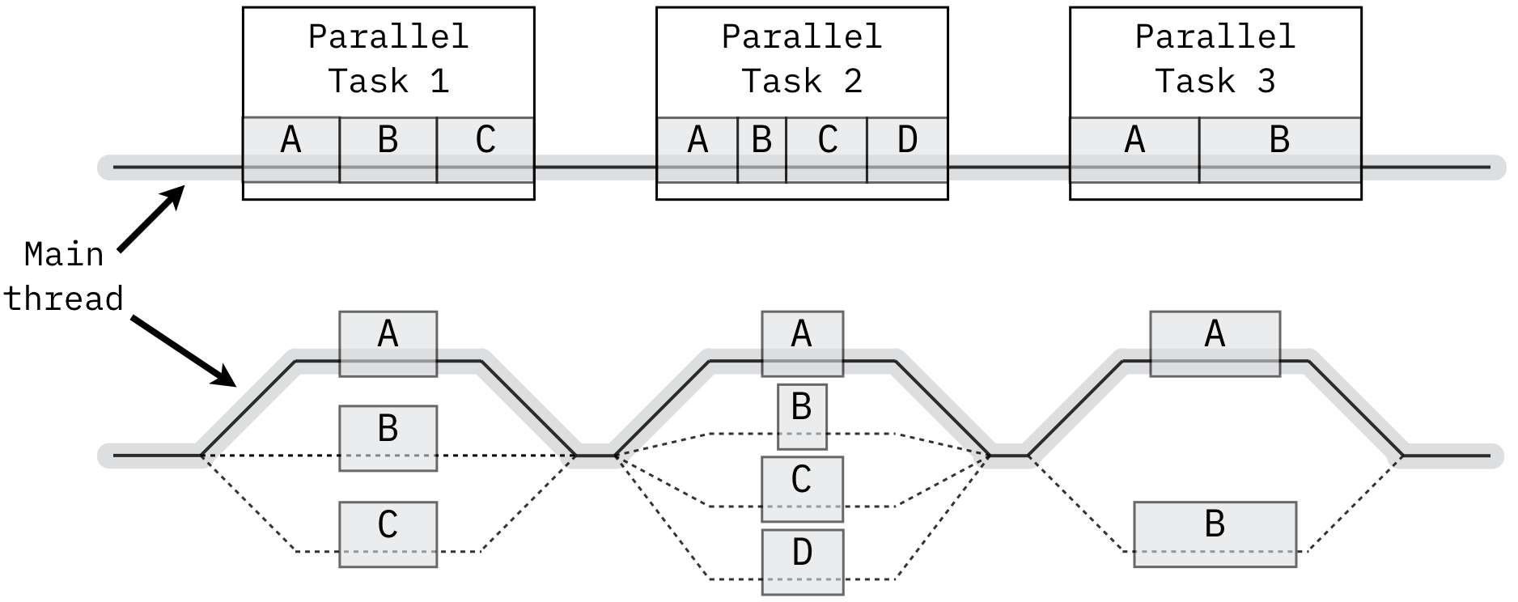
Fork/join
The fork/join pattern uses a main thread that spawns additional threads when there are parallel tasks to be done
After those tasks complete, the main thread joins the spawned threads
A fork/join pattern could be used for either task parallelization or data parallelization

Slide 92
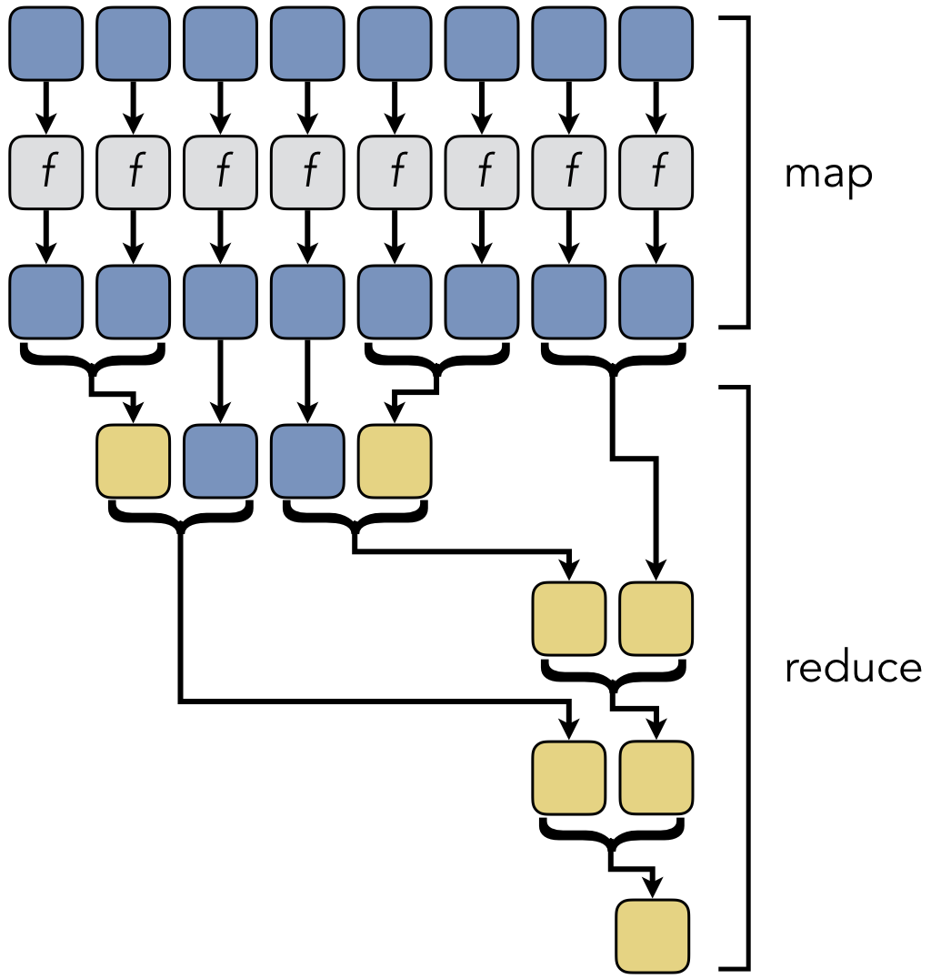
Map/reduce
Map/reduce is similar to fork/join
The biggest difference is a philosophical one about how the work is described
Map/reduce has two stages:
Map applies a function to each piece of input data
Reduce combines the results to get a final answer
Map/reduce is commonly used on clusters and distributed systems
The open source Apache Hadoop is a popular tool for map/reduce computing

Slide 93
Manager/worker
The manager/worker thread pattern is commonly used with task parallelism
Independent tasks are given to work threads that communicate with a central management thread
Event handling, for example, can be viewed as manager/worker
Workers can also wait for a data value to change from NULL, as in the code below
void * worker (struct args * _args)
{
struct args *args = (struct args *) _args;
pthread_mutex_lock (args->lock);
while (true)
{
while (args->data == NULL) // Wait for data
pthread_cond_wait (args->data_received, args->lock);
if (! args->running) pthread_exit (NULL);
// Process data
}
}

Slide 94
Thread pools
Rather than worrying about creating too many threads initially or dynamically creating threads, one approach is a thread pool
A thread pool is a fixed number of threads with a queue of tasks
When a thread finishes its work, it can dequeue a new task
Thread pools advantages:
The cost of creating threads is only paid once
Resource consumption is more predictable because there won't suddenly be a lot more threads
Each thread self-manages the load by getting more work when it finishes
Thread pools disadvantages:
Cache performance can be poor because there's no coordination between which thread is doing what
Crashes and errors can be hard to recover from since we won't know which thread was doing the thing that failed
Managing the task queue requires synchronization that could slow things down

Slide 95
Limits of Parallelism

Slide 96
Speedup
Speedup is how much faster a parallel solution is compared to a sequential one
The formula is $\frac{T_{sequential}}{T_{parallel}}$
$T_{sequential}$ is the amount of time the sequential solution takes
$T_{parallel}$ is the amount of time the parallel solution takes
Thus, if a sequential solution to a problem takes 100 seconds, and the parallel solution takes 50 seconds, the speedup is 2

Slide 97
Amdahl's Law and strong scaling
What if you had 16 cores? Or 1,000 cores? Or a million?
How much speedup can you get?
Some part of the program has to be executed sequentially
Reading input
Starting threads
Combining results
Amdahl's law says that the maximum speedup possible is $\frac{1}{\left(1−p\right)+\frac{p}{N}}$
$p$ is the fraction of a program that can be parallel
$N$ is the number of processors

Slide 98
Consequences of Amdahl's law
What if we had unlimited cores?
We can take the equation $\frac{1}{\left(1−p\right)+\frac{p}{N}}$ and plug in $∞$ for $N$
Doing so would mean, even with infinite cores, we could never have better speedup than $\frac{1}{\left(1−p\right)}$
Let's say that 90% of a program can be parallelized
What's the maximum possible speedup you can get?
$S=\frac{1}{\left(1−p\right)}=\frac{1}{\left(1−.9\right)}=\frac{1}{.1}=10$

Slide 99
Timing in Distributed Environments

Slide 100
Timing in distributed environments
When working on a single computer, there's only one clock
Thus, multiple threads can use this clock to record events in a mutually consistent way
Like adding timestamps to log files
Distributed systems don't have a single, reliable clock
Each computer might have a slightly (or completely) different time
Clocks on each computer drift with respect to each other
These problems get worse as distance (and network delays) increase

Slide 101
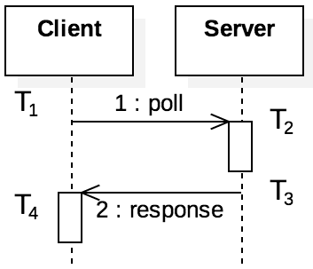
Clock synchronization
We can synchronize clocks based on a centralized server
A problem is that the time a message takes in the network is unpredictable
Network Time Protocol (NTP) is a protocol to do this:
Client sends a message at T₁
Server receives the message at T₂
Server replies at T₃
Client receives the message at T₄
Offset = $\frac{\left(T_{2}−T_{1}\right)+(T_{3}−T_{4})}{2}$
The offset is a measurement of the difference in times between the client and server
Delay = $\left(T_{4}−T_{1}\right)−(T_{3}−T_{2})$
The delay is a measurement of how long it takes for the messages to make a round trip
Algorithms process a number of offset and delay values to try to find the most accurate offset

Slide 102
Lamport timestamps
Logical clocks are an alternative to using exact times, using messages to track the order of events
Lamport timestamps are a way to implement logical clocks
Each process keeps an internal counter of events that it sees
When a local event occurs, the counter is incremented
When a process sends or receives a message, it increments its counter
Messages have timestamps
When a process receives a message, it updates its internal counter to the message's timestamp if that timestamp is larger

Slide 103
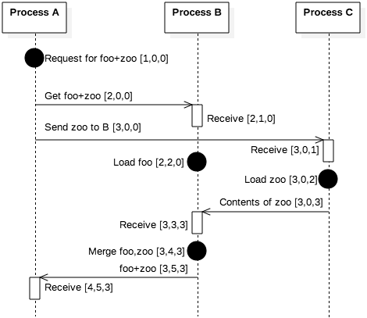
Vector clocks
Lamport timestamps only give indirect information about the state of other processes
Vector clocks extend the idea of Lamport timestamps by making every process keep a counter for every process
When a message from one process arrives, the receiving process can update all of its counters based on whatever is larger
Vector clocks give much more information about how many events have been experienced by other processes

Slide 104
Reliable Storage and Location

Slide 105
Reliable data storage
If you want to get a file from a web server, you can go to a URL and make an HTTP request
Unfortunately, if that server is down or unreachable, you can't get the file
For this reason, distributed systems are often used to store data
A key feature of distributed data storage is replication, keeping multiple copies of the same data
Replication avoids a single point of failure
If done correctly, replication can also do load balancing, improving performance by providing multiple sources for data

Slide 106
Google File System
The Google File System (GFS) is a distributed storage system
GFS was designed to store Google's internal data, like the data structures used for PageRank
Files are often large, so they're broken into chunks
Chunks are stored on chunkservers as regular files
A master server stores a table mapping files chunks to their locations

Slide 107
Distributed hash tables
GFS was designed by Google for its own purposes
It uses a central server
Servers keep information about each other
What if we have no idea what servers are going to be in the network?
Distributed hash tables (DHT) are an approach for mapping arbitrary objects to arbitrary servers
DHTs are a way to organize a peer-to-peer network to avoid query flooding

Slide 108
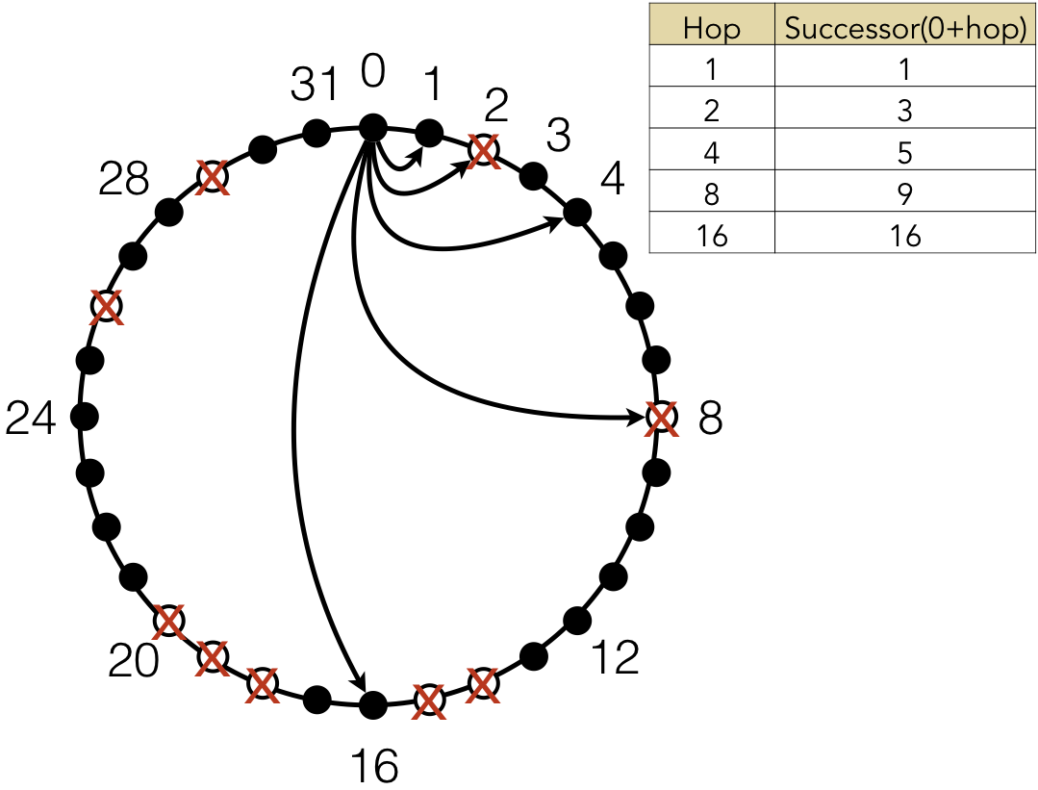
Chord DHT
Chord was one of the first algorithms for a DHT, introduced in 2001
Each node has a unique identifier (often its IP address) that's hashed to provide a location in a circle
If the hash is n bits long, the DHT can support up to 2^{n} nodes
Most locations in the circle are empty
Each node has a "finger table," tracking successor elements in increasing powers of 2 away on the circle
If the power of 2 node is missing, it tracks the next non-missing node
The example on the right is only for 2⁵ = 32 nodes

Slide 109
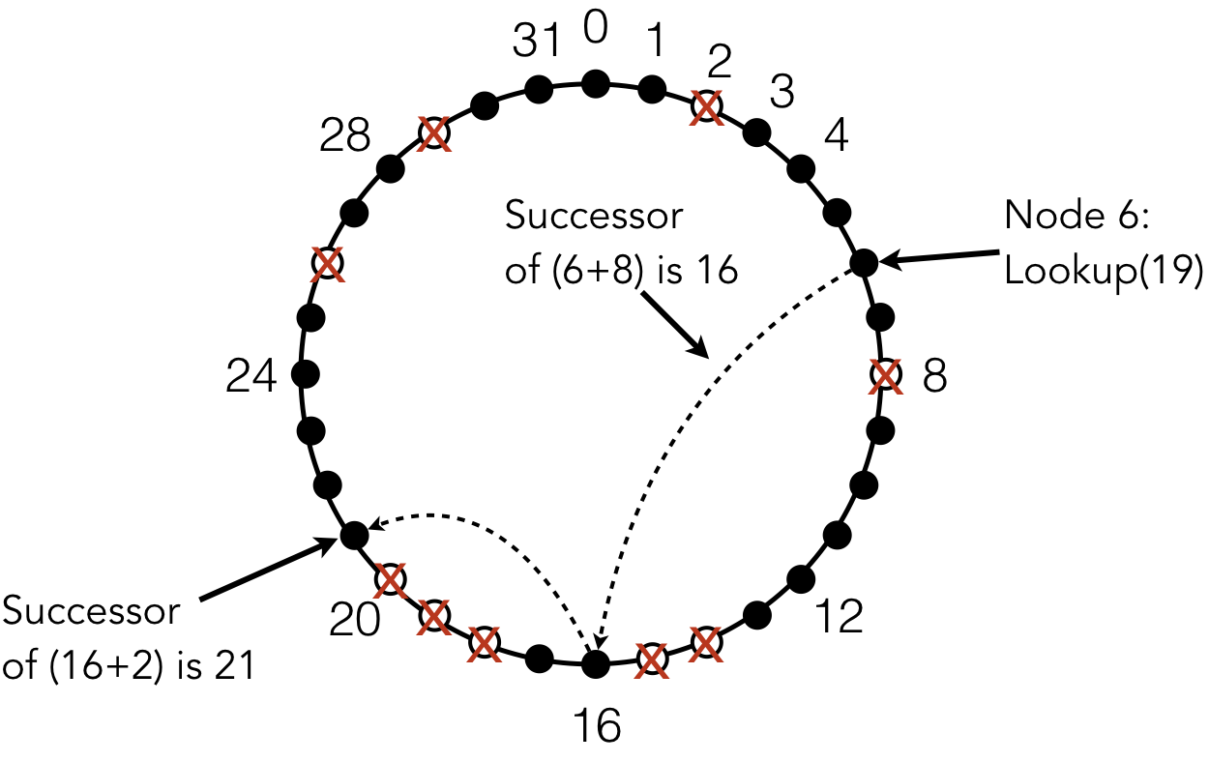
Files in Chord DHT
When a file is added, it's hashed
Whichever node has that hash value (or is its successor) is the location of that file
On the right, node 6 is looking for a file at location 19 (the successor of 18)
It looks at 6 + 8 = 14, which doesn't exist but has a successor of 16
Then it looks at 16 + 2 = 18, which doesn't exist but has a successor of 21
Node 21 is where the file is supposed to be
The details get a little more complex, but the practical result is that a file can be found with O(log n) requests, where n is the size of the network
Replication is done by caching files at nodes that were part of the lookup to find the file

Slide 110
Consensus in Distributed Systems

Slide 111
Consensus
Reaching consensus is the goal of many distributed protocols
To reach consensus, a protocol must have three properties:
Termination: Every correct (non-failing) process will eventually decide on a value
Integrity: If every correct process proposes the same value, any correct process must decide that value
Agreement: All correct processes decide the same value
Examples
In GFS, a consensus protocol could tell any node whether a particular file was on a particular node
In NTP, nodes will be able to agree on synchronized time

Slide 112
Failure
However, processes do fail in distributed systems
Failure could mean making some error, crashing, going into an infinite loop, or losing connection to the network
Processes could even be malicious, trying to undermine the system
Even in the face of (many?) failures, we'd like the distributed system to reach consensus
A common analogy used to describe this problem is the Byzantine generals problem

Slide 113
Byzantine generals
A version of the Byzantine generals problem imagines:
One general is the commander who decides what to do
The other two are lieutenants who check with each other to make sure that they got the same message from the commander
What if there's one bad general?
A bad commander could send retreat to one lieutenant and attack to the other
A bad lieutenant could receive attack from the commander but send retreat to the other lieutenant
A good lieutenant couldn't distinguish between those two situations

Slide 114
Limits on consensus
Consensus is hard
Failing processes can mess things up for correct processes
Because there's limited information, a process can appear to be correct to one part of the system and failing to another
A Byzantine failure is exactly this kind
There's conflicting information, and it's impossible to determine what's reliable

Slide 115
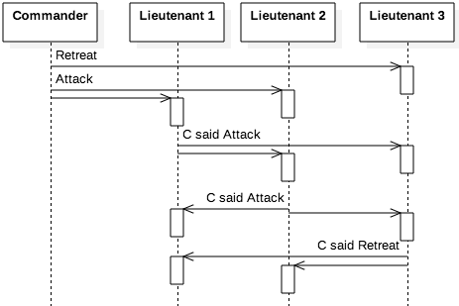
The 1/3 limit
It's not an accident that the number of generals chosen is three
If strictly less than 1/3 of the nodes are failing, it's possible to achieve consensus
If we extend the problem to four generals (three lieutenants), then generals who are working can decide on a consensus using majority rule
Even a bad commander who issues confusing orders won't mess up the system
However, knowing what the consensus is doesn't tell us which nodes are failing
Also, this 1/3 limit depends on synchronous communication

Slide 116
Blockchains
Blockchains are a form of distributed ledger
Unlike banks, which are centralized authorities for transactions that have occurred at the banks, blockchains try to record transactions in a distributed way with no central authority
Although similar ideas existed before, blockchains as we know them were invented by Satoshi Nakamoto (real identity unknown) in 2008
The original blockchain idea was intended to keep track of bitcoin transactions
Now, most cryptocurrencies use some form of blockchain to track transactions

Slide 117
Double-spending
Blockchains are distributed systems that can be used to record almost anything
But their use has been dominated by cryptocurrency
A central problem that any digital money faces is double-spending
What stops someone from spending a digital token more than once?
Transactions are recorded in blockchains
Two competing blockchains could record different transactions, but the longer chain is considered the valid one

Slide 118
Proof-of-work
Blockchains are built by recording transactions along with other data that hashes in a specified pattern
Usually, a hash value with a certain number of zeroes at the beginning
It's easy to check that the transaction has the right hash value
But it's computationally difficult to generate data that has a hash with a certain number of zeroes at the beginning
And that's what mining is: Trying random strings until something has the right hash value
Since a large number of strings will have the right hash value, an entity with more than 50% of the computational power working on a blockchain network could outpace everyone else writing transactions, taking control of it

Slide 119
Libraries You Should Know

Slide 120
String manipulation
String manipulation is annoying but necessary in C
You should be able to use the following functions:
char *strcat(char *dest, const char *src)
Appends the string src to the end of the string pointed dest
char *strncat(char *dest, const char *src, size_t n)
Appends the string src to the end of the string dest, up to n characters
char *strchr(const char *str, int c)
Searches for the first occurrence of the character c (an unsigned char) in the string str
int strcmp(const char *str1, const char *str2)
Compares strings str1 and str2
int strncmp(const char *str1, const char *str2, size_t n)
Compares at most the first n bytes of strings str1 and str2
char *strcpy(char *dest, const char *src)
Copies the string src into dest
char *strncpy(char *dest, const char *src, size_t n)
Copies up to n characters from the string src into dest
size_t strlen(const char *str)
Computes the length of the string str
char *strstr(const char *haystack, const char *needle)
Finds the first occurrence of string needle in the string haystack
char *strtok(char *str, const char *delim)
Breaks string str into a series of tokens separated by delim

Slide 121
File I/O
File I/O is the key abstraction for all I/O in Linux
So you should be able to use the following functions:
int open (char *path, int flags, int perms)
Open the file specified by path
Possible flags: O_RDONLY, O_WRONLY, O_RDWR, O_CREAT, O_APPEND, O_TRUNC
Permissions: Only needed when creating a file, and octal values are the easiest
int close(int fd)
Close the file given by file descriptor fd
int read (int fd, char *buffer, int size)
Read from file descriptor fd into buffer a maximum of size bytes
Returns the number of bytes successfully read
int write(int fd, char *buffer, int size)
Write from buffer into file descriptor fd a maximum of size bytes
Returns the number of bytes successfully written

Slide 122
Process management functions
You should know these pretty well:
pid_t fork (void)
Fork a new version of the current process at exactly the same point in the program
int execl(char *path, char *arg0, ..., NULL)
int execle(char *path, char *arg0, ..., NULL, char* envp[])
int execlp(char *file, char *arg0, ..., NULL)
int execv(char *path, char *argv[])
int execve(char *path, char *argv[], char *envp[])
int execvp(char *file, char *argv[])
Execute a process (replacing the current process) with the given arguments and environment variables
pid_t wait(int *stat_loc)
Wait for all child processes to finish
int pipe(int pipefd[2])
Create a pipe where pipefd[0] is the reading end of the pipe and pipefd[1] is the writing end
int dup2(int actual, int replaced)
All reads from and writes to replaced will actually be read from or written to actual

Slide 123
Networking
You don't need to have these functions memorized, but you should be familiar enough to read them in code and understand them
int socket (int domain, int type, int protocol)
Create a socket, which will work like a file descriptor
int bind (int socket, const struct sockaddr *address, socklen_t address_len)
Bind the socket to a port
int listen (int socket, int backlog)
Set up the socket for listening
int accept (int socket, struct sockaddr *address, socklen_t *address_len)
Accept an incoming connection
int connect (int socket, const struct sockaddr *address, socklen_t address_len)
Connect to a listening socket

Slide 124
Threads
You don't need to have these functions memorized, but you should be familiar enough to read them in code and understand them:
int pthread_create (pthread_t *thread, const pthread_attr_t *attr, void(*start_routine)(void*), void *arg)
Create a new thread
void pthread_exit (void *value_ptr)
Exit from the current thread, possibly returning a result
void pthread_join (pthread_t thread, void *value_ptr)
Wait for a thread to end (getting a pointer to its result, if any)

Slide 125
Synchronization
You don't need to have these functions memorized, but you should be familiar enough to read them in code and understand them:
sem_t *sem_open (const char *name, int flag,
/* mode_t mode, unsigned int value */ )
Return (and possibly create) a named semaphore, using the usual flag and mode constants
value determines the initial value of the semaphore (often 0)
int sem_wait (sem_t *sem)
Block if the semaphore's value is 0, decrement after continuing
int sem_post (sem_t *sem)
Increment the semaphore's value, unblocking a process if the value is 0
int pthread_mutex_init (pthread_mutex_t *mutex,
const pthread_mutexattr_t *attr)
Create a mutex with the specified attributes
int pthread_mutex_lock (pthread_mutex_t *mutex)
Acquire a mutex, blocking until you succeed
int pthread_mutex_unlock (pthread_mutex_t *mutex)
Release the mutex

Slide 126
Upcoming

Slide 127
Next time…
There is no next time!

Slide 128
Reminders
Finish Assignment 8
Due tonight before midnight!
Study for the final exam:
Wednesday, April 30, 2025
8:00 – 10:00 a.m.

